Slide 1

Adrian Tiron
Vesta Admin Takeover
Exploiting Reduced Entropy in bash $RANDOM

Slide 2
whoami
Adrian Tiron, Founder & Principal Consultant at FORTBRIDGE
Accreditations: OSCP/OSEP/CRTO/CRTL/AWS/Azure
Past History: Contractor, Jack of all trades

Slide 3
What is this TALK about?
Password reset tokens (my favorite)
Application Security
Web + binary mixture

Slide 4
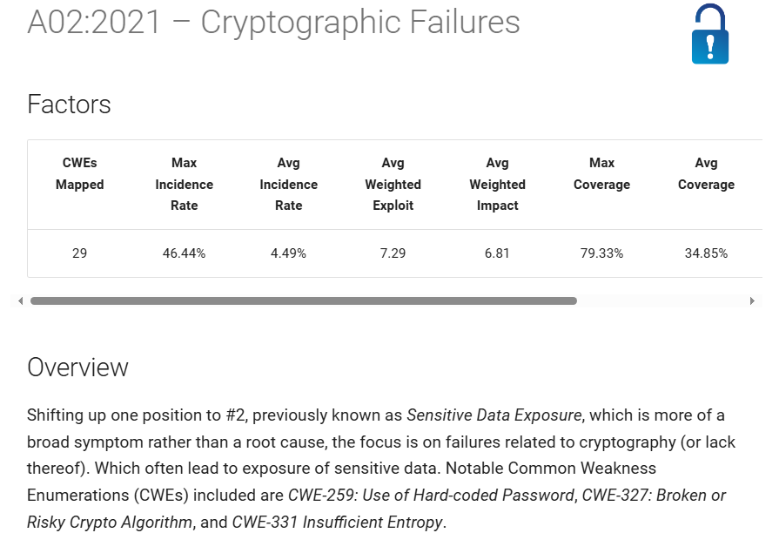
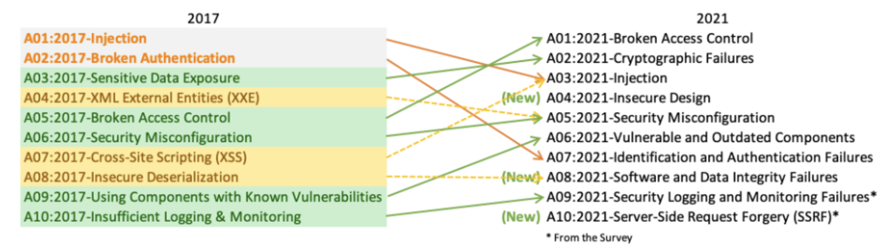
OWASP Top 10 - #2 Security Risk

Slide 5
About Vesta CP
web based control panel, similar to cPanel/WHM/Plesk
manages domains/websites/databases/dns/cron/backups etc
lightweight, exposes a PHP api which calls bash scripts for the heavy work
acquired last year around the time we reported this Critical issue

Slide 6
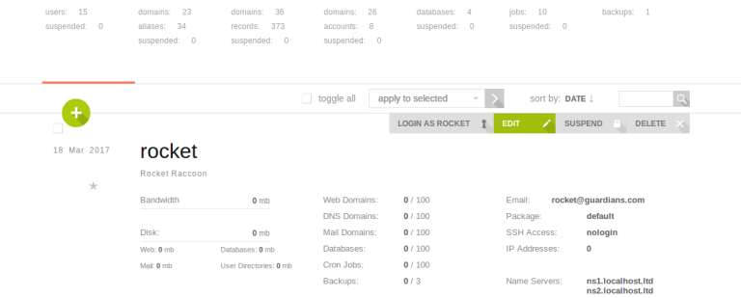
VESTA CP Dashboard

Slide 7
VESTA CP – White Box
Source code is available, let’s do white box
Code is PHP, easy to read, no OOP, no frameworks
issues reported previously cve.mitre.org/cgi-bin/cvekey.cgi?keyword=vesta
Let’s review 2 dodgy code patterns first just for fun ( some of our failures)

Slide 8
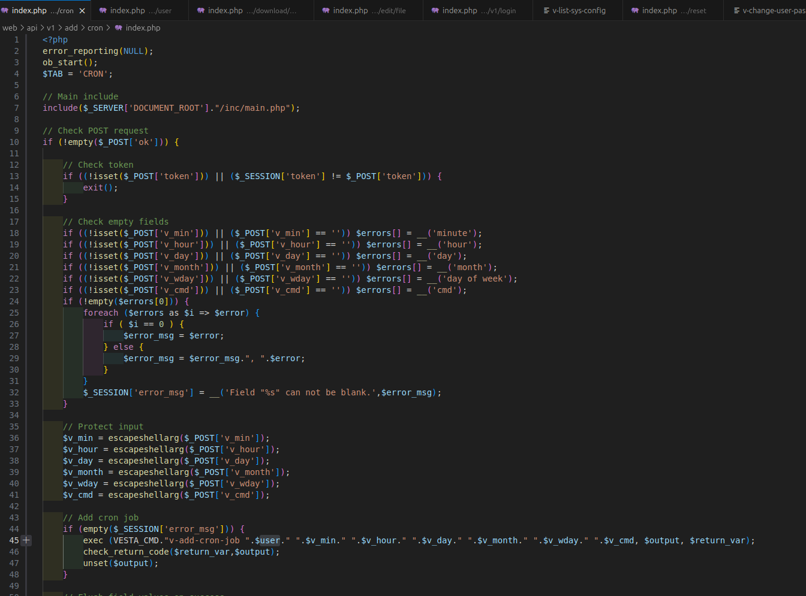
VESTA CP – Dodgy code pattern #1
Add cron
All vars escaped, except $user
Inject in $user for RCE?

Slide 9
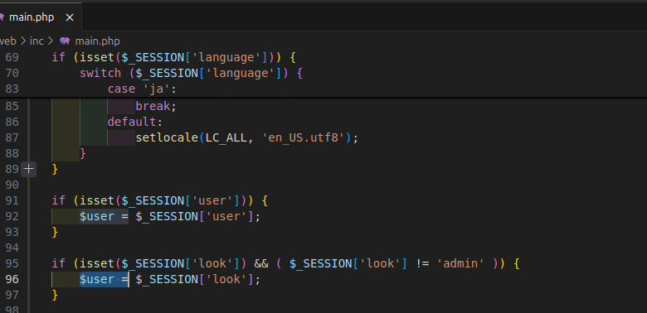
VESTA CP – Dodgy code patern #1
add cron continued
inject in $user for RCE?
$user comes from $_SESSION; $_SESSION pollution?
no explicit Auth check (in many places)
patches In many files, but not centralized

Slide 10
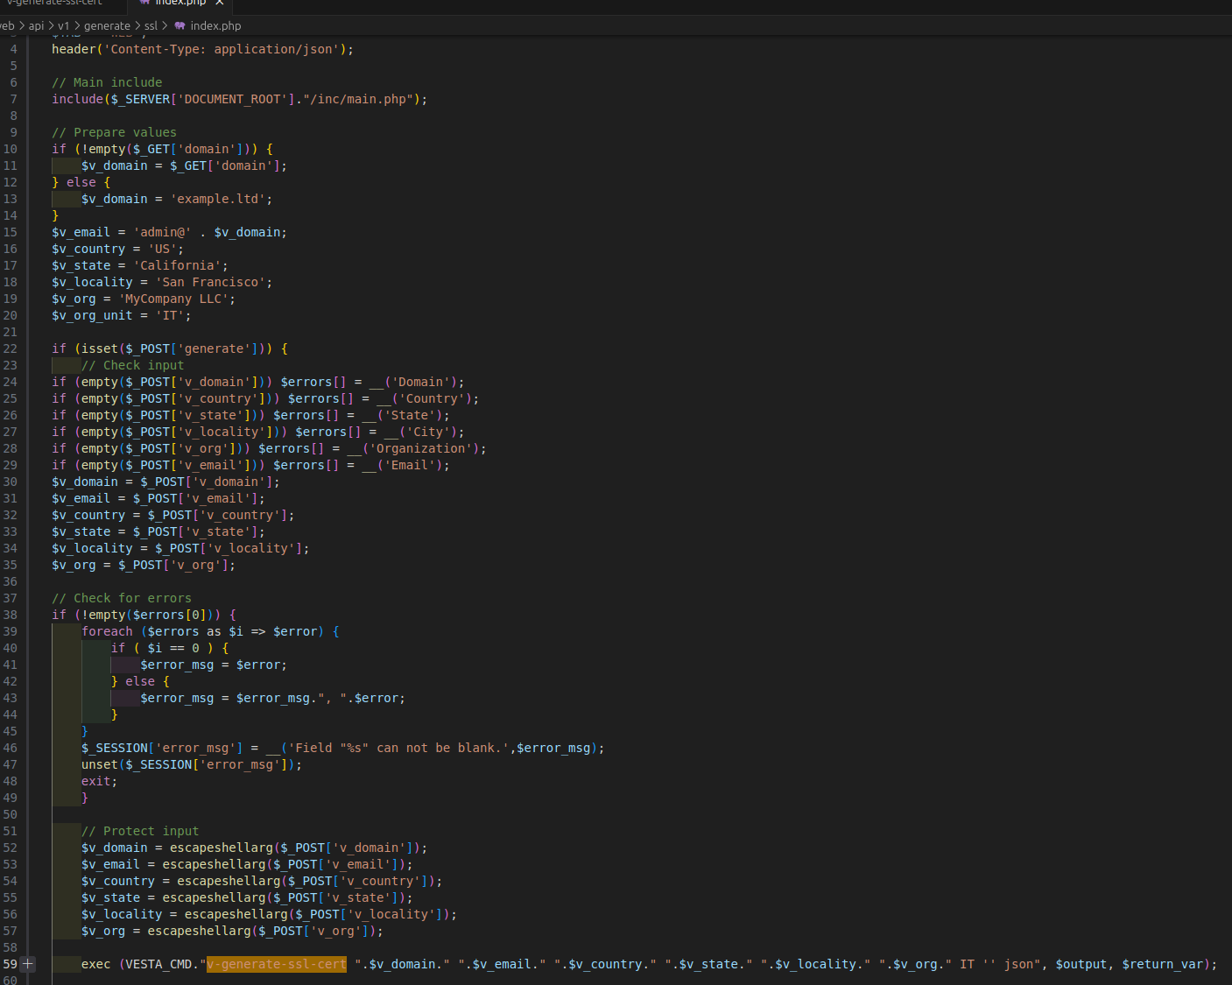
VESTA CP – Dodgy code patern #2
V-gen-ssl-cert, no Auth at all
You can generate ssl certs at will
You need an escapeshellarg 0day
Tried to fuzz escapeshellarg, no luck

Slide 11
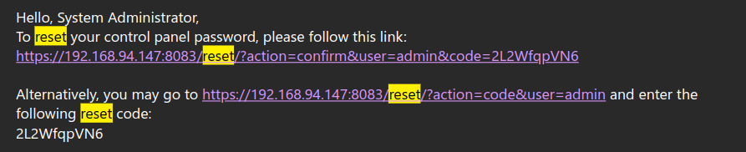
Vesta CP – The Password Reset process
Standard password reset email
Un-auth-ed attack surface (<3)
How’s the code generated?

Slide 12
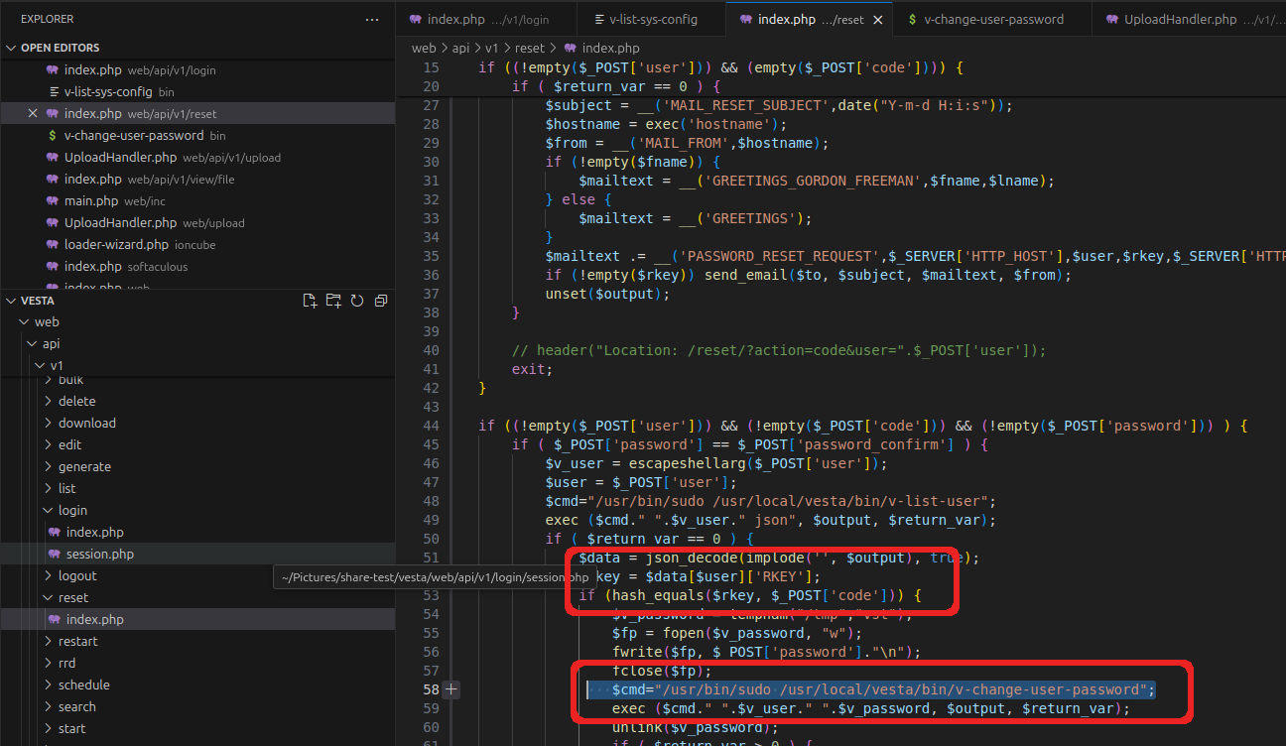
PHP api/v1/reset/index.php

Slide 13
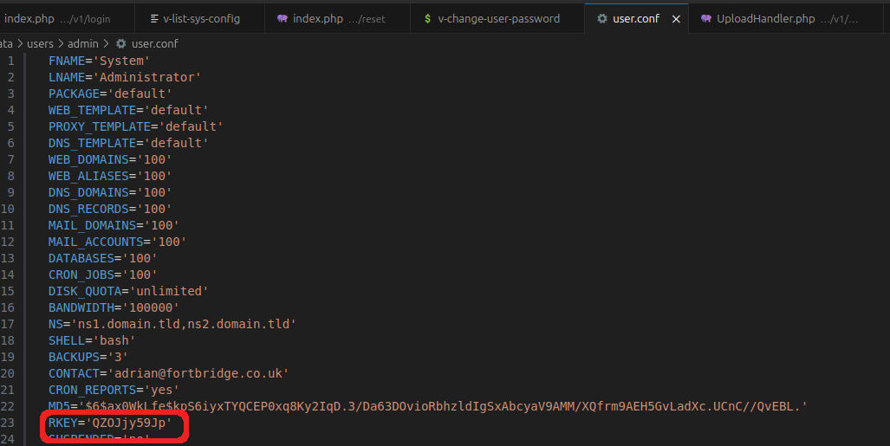
Vesta CP – What is RKEY ?
pre-generated (install time or for every successful password reset)
you have to know it to change it
stored for every user in user.conf
RKEY is the password reset token

Slide 14
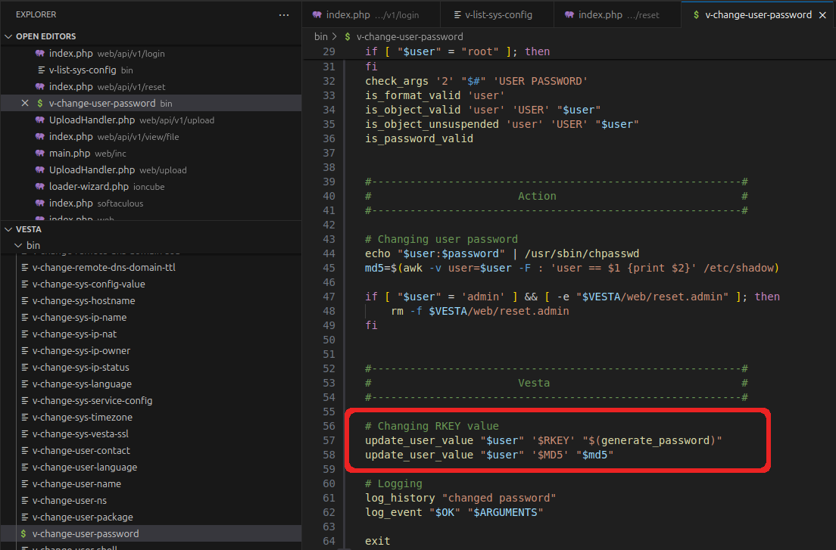
Vesta CP v-change-user-password
PHP API calls this bash script
it changes the user password AND
it generates RKEY for the NEXT pass reset
v-change-user-password

Slide 15
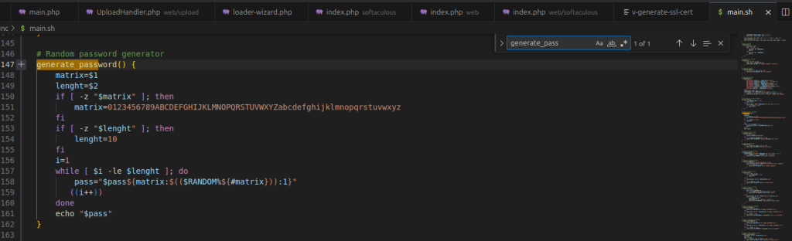
Vesta CP – generate_password
uses Bash $RANDOM env variable
not crypto secure
between 0 and 32767
modulo operator to get an index within the string limits

Slide 16
Vesta CP – attacking $RANDOM
$ bashrand crack -n 3 $RANDOM $RANDOM $RANDOM
Seed: 2137070299 +3 (old) # Seed found
Next 3 values: [22404, 16453, 2365] # predicting the next random numbers
$ echo $RANDOM $RANDOM $RANDOM
22404 16453 2365 # generating next 3 $RANDOM and they match with the 3 above
#seed it and generate the next random numbers everytime
$ RANDOM=1337; echo $RANDOM $RANDOM $RANDOM
24879 21848 15683
$ RANDOM=1337; echo $RANDOM $RANDOM $RANDOM
24879 21848 15683
https://github.com/jorianwoltjer/bashrandomcracker

Slide 17
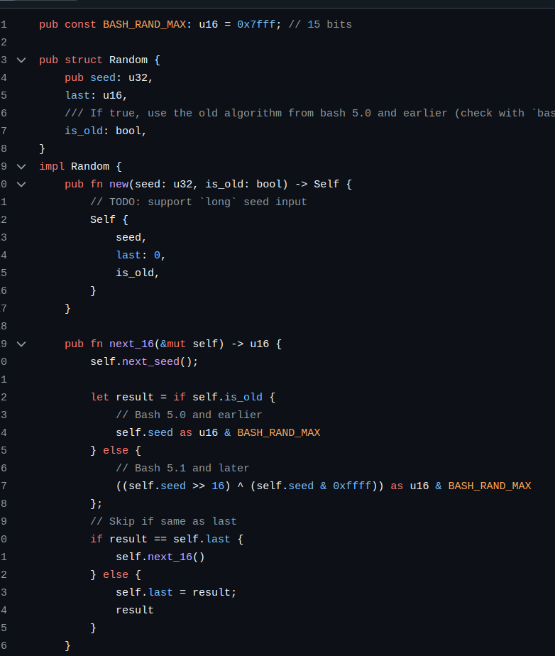
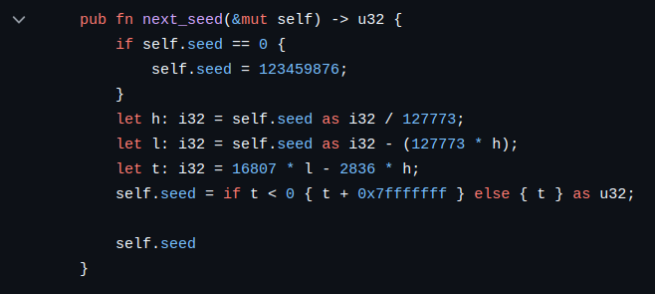
Vesta CP – $RANDOM algorithm

Slide 18
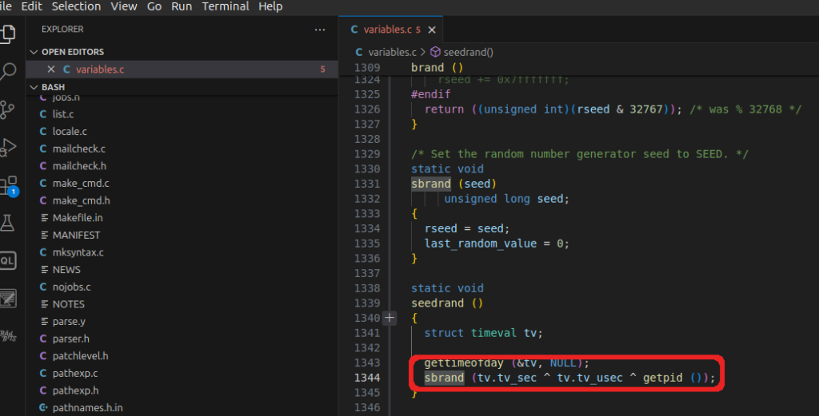
Vesta CP – dive into bash internals
Seeding done with
timestamp
microseconds
getpid()

Slide 19
Vesta CP – Initial ideas
Bruteforce all values (4.3 Billion) – terrible idea
getpid() and microseconds are easier to brute-force
Most important is the timestamp – Info Leak?
found endpoints that exposed useful timestamp but require Auth
A useful timestamp is the timestamp of the last password reset
Know any other tricks? Please share :D

Slide 20
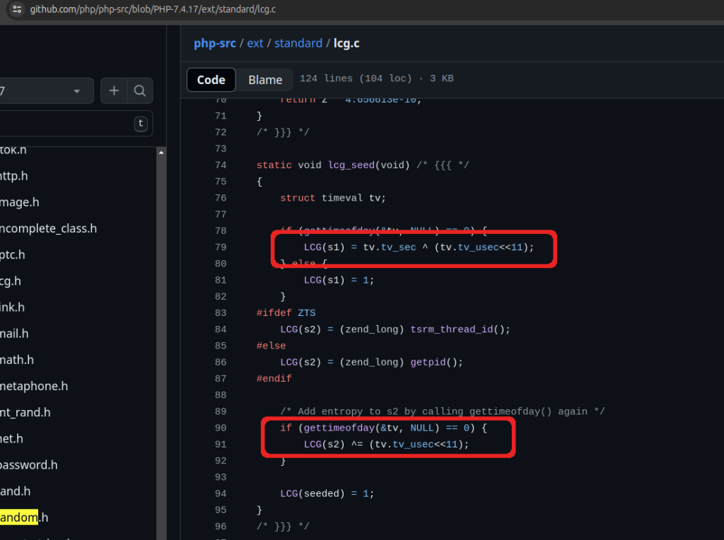
Vesta CP – PHP internals
out of ideas, reviewing PHP core
LCG function uses s1 and s2
what’s with the left bitshift?
tv.tv_usec needs 20 bits

Slide 21
Vesta CP – PHP seeding vs Bash seeding
no bit shifting in bash !?!
we’re XOR-ing 3 ints
could this be a problem?

Slide 22
Vesta CP – The issue with Seeding (“AHA!”)
The issues are the following:
tv.tv_sec – the current timestamp and occupies 8 bytes but uses only 4 bytes in practice. You can store timestamps up to year 2038 on just 4 bytes.
tv.tv_usec – the microseconds and occupies 8 bytes, but uses 20 bits in practice (there’s 1.000.000 microseconds in a second and 20 bits is enough to store this)
getpid() – the process pid and occupies 4 bytes and the max value we’ve seen in our tests was around 660000, which needs 20 bits*.
Thus, the XOR operation will only change the lower 20 bits. There’s no bit shifting here, unlike in the PHP core. This was the “AHA” moment.
NOTE: getpid() could be the only deal breaker here, but it would have to be a really high number to break our exploit. This would happen on a system running for a very long time or if there is a fork() bomb.

Slide 23
Vesta CP – The issues summarized
By only changing the lower 20 bits of the current timestamp, we reduce entropy, and the seed will fall within an interval of approximately 12 days around the current timestamp.
On the next slide, we’ll calculate the minimum (with the lowest 20 bits set to 0) and the maximum (with the lowest 20 bits set to all 1’s).
It should be clear that the timestamp is the only factor that matters here, and the PID of the process and the microseconds are irrelevant.

Slide 24
Vesta CP – Sample PHP code for visualization
<?php
$timestamp = time();
echo "Original Timestamp: " . $timestamp . "\n";
echo "Orig Date: " . date('y-m-d H:i:s', $timestamp) . "\n";
// Create a mask where the lowest 20 bits are 0
echo "\n\n";
$mask = ~((1 << 20) - 1);
$modifiedTimestamp = $timestamp & $mask;
echo "Mask 20 bits - set to 0\n";
echo "Modified Timestamp: " . $modifiedTimestamp . "\n";
echo "Timestamp in Binary: " . decbin($modifiedTimestamp) . "\n";
echo "Modified Date: " . date('y-m-d H:i:s', $modifiedTimestamp) . "\n";
echo "\n\n";
// Create a mask where the lowest 20 bits are 1
echo "Mask 20 bits - set to 1\n";
$end = $timestamp | ((1 << 20) - 1);
echo "end Timestamp: " . $end . "\n";
echo "end Date: " . date('y-m-d H:i:s', $end) . "\n";
echo "end Timestamp in Binary: " . decbin($end) . "\n";
?>

Slide 25
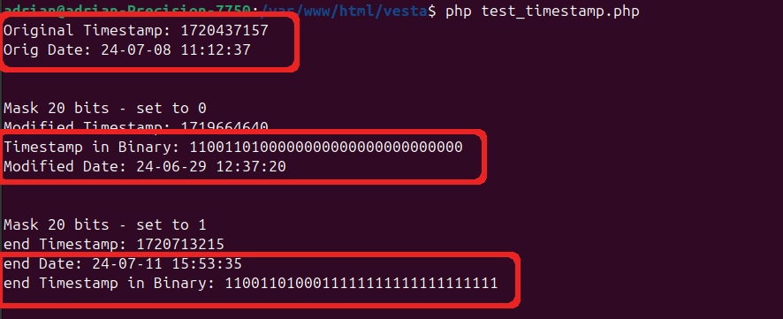
Vesta CP – PHP output
=
Output to show how XOR affects the timestamp [min,max]

Slide 26
Vesta CP – “Local” exploit to test our theory
we’ve extended BashRandomCracker
added a method to bruteforce all 4B+ seeds (because rust is fast)
can we generate a password reset token that is stored in the vesta user.conf file?
we don’t really need to brutefoce 4B+
bruteforce the timestamps for the past 1-3 years, in reverse chronological order

Slide 27
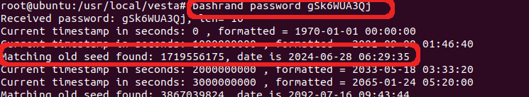
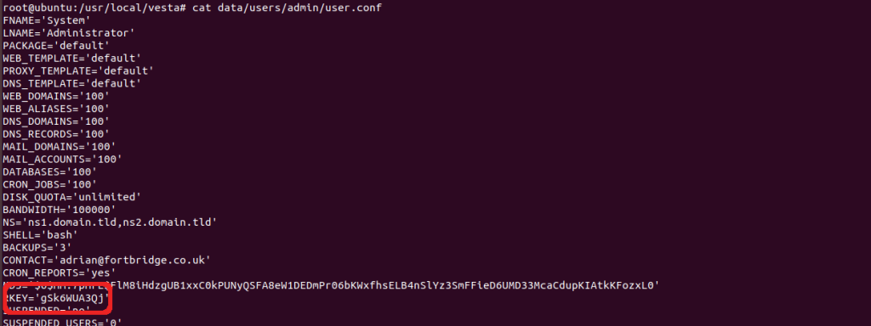
Vesta CP – “Local” exploit output
Brute-forcing the RKEY for local testing

Slide 28
Vesta CP – Turbo Intruder FTW
https://github.com/FORTBRIDGE-UK/vesta-poc Turbo Intruder Script
Brute-force [2023-2024], then [2022-2023] etc
There’s 31.5M attempts / year (86400*365)
Brute-force for 3 years, that’s ~95M requests, which is 98% optimization
For other Turbo Intruder optimization tips see: fortbridge.co.uk/research/multiple-vulnerabilities-in-concrete-cms-part1-rce/

Slide 29
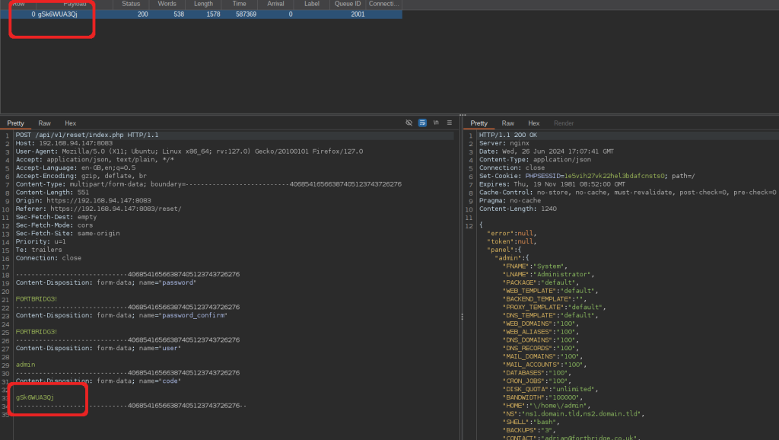
Vesta CP – The Glorious Win
Remote exploit with Turbo Intruder script

Slide 30
Vesta CP – Fix & Conclusion
Migrate to Hestia CP
Vesta CP is discontinued
Use Crypto Secure functions
Do pentests & code reviews for maximum efficiency (deep bugs)
Audit your entire stack

Slide 31
See Our Leading Research Insights
For web app pentest research and a peek into PHP internals, check Multiple Concrete CMS Vulnerabilities (Part 1 – RCE): This article investigates achieving remote code execution through 2 race conditions vulnerabilities in the file upload functionality in Concrete CMS, providing a detailed examination of potential security risks and mitigation strategies.
For Mobile & API testing research, check Feeld dating app – Your nudes and data were publicly available: This article details investigates the importance of securing GraphQL endpoints properly in order to prevent massive information data leaks.
For our open source contribution to security tools, check Phishing Like a Pro: A Guide for Pentesters to Add SPF, DMARC, DKIM, and MX Records to Evilginx: This guide delves into advanced phishing techniques and how to effectively use SPF, DMARC, DKIM, and MX records with Evilginx for penetration testing.

Slide 32

Let's connect​

